Slide 1

Rashik Rahman
ID : 17201012
Sec : A2

Slide 2
Project Topic 7 segment display counter (0-9999)
Welcome
1

Slide 3
Project Description
I will be developing a counter that will count from 0 to 9999 and show it in a 7 segment display. This counter can be used to keep track of any count. One can use it to count the number of a their favorite vehicle they have seen in a day or a doctor can keep count how many serious patients have he seen in a day etc. I will we using Arduino IDE and proteus simulation software for this project.
Required things in simulator :
7 segment display x 1
Arduino UNO x 1
Not gate x 4
Button x 1

Slide 4
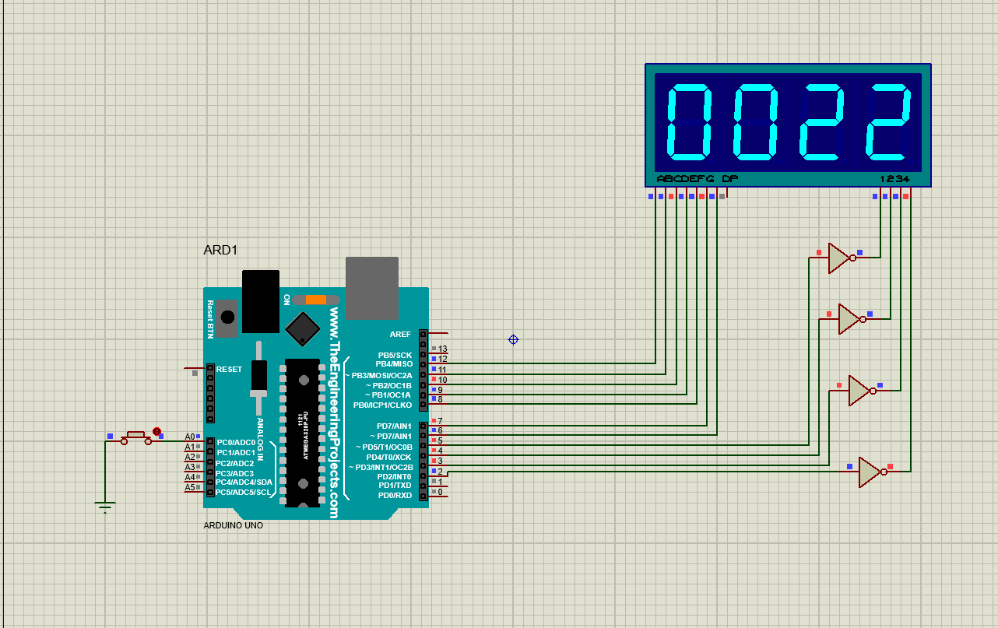
This is a digit segmentation of a 7 segment display. So I have defined pin 6-12 for these 7 segments. And Dig1-Dig4 are how many digits the number have. Counter_digit is to keep track of the how many digits are in the number and count is to count the number.

Slide 5
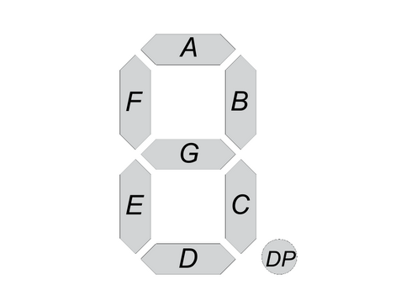
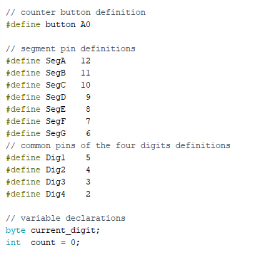
This is a digit segmentation of a 7 segment display. So I have defined pin 6-12 for these 7 segments. And Dig1-Dig4 are how many digits the number have. Counter_digit is to keep track of the how many digits are in the number and count is to count the number.

Slide 6
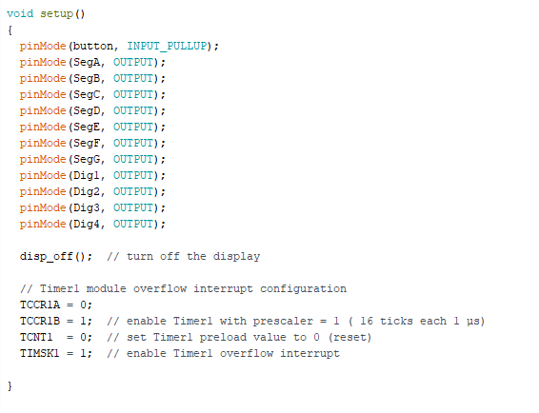
This is the setup part of the code segment. Here I define the pin modes and ISR variables.

Slide 7
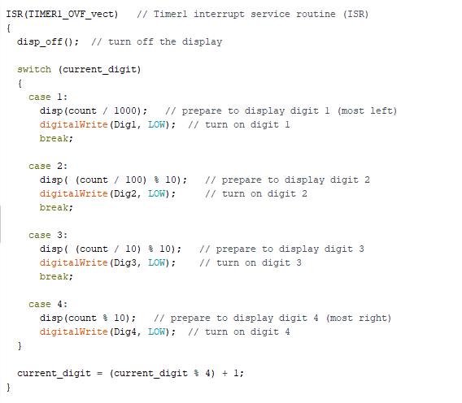
What is an interrupt?
The program running on a controller is normally running sequentially instruction by instruction.
An interrupt is an external event that interrupts the running program and runs a special interrupt service routine (ISR).
After the ISR has been finished, the running program is continued with the next instruction. Instruction means a single machine instruction, not a line of C or C++ code.

Slide 8
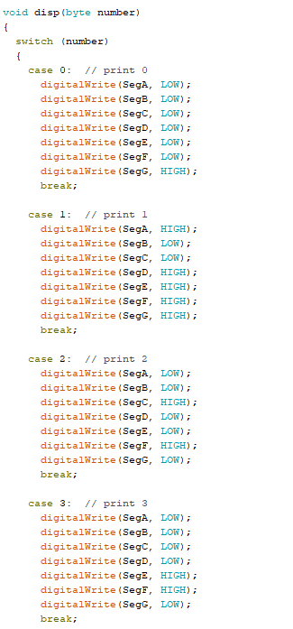
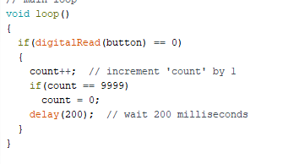

Slide 9
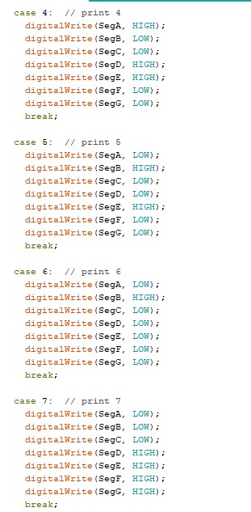
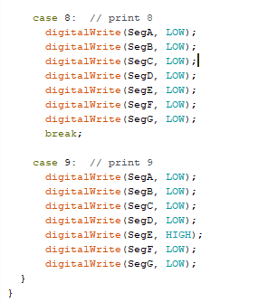

Slide 10
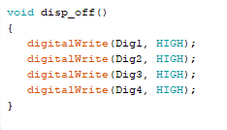
Any Questions?

Slide 11

Thank You !
Rashik Rahman

